Slide 1

Judiciary
Hasan Muhammad Baniamin

Slide 2
Functions of Judiciary
1. Interprets the law:
A number of cases are brought before the judge, where law is not clear, or laws are silent – in these matters judges gives their decisions. Later, these decisions are quoted in similar cases.
2. Protecting Civil Rights: People are given away many rights by the state through the laws of the parliament. The court protect these rights.
3. Custodian of Fundamental Rights: Constitution grant many fundamental rights to citizen,
4. Guardian of the Constitution:
5. Miscellaneous: Advisory, Resolve conflicts of jurisdiction between the Centre and State Government in Federations.

Slide 3
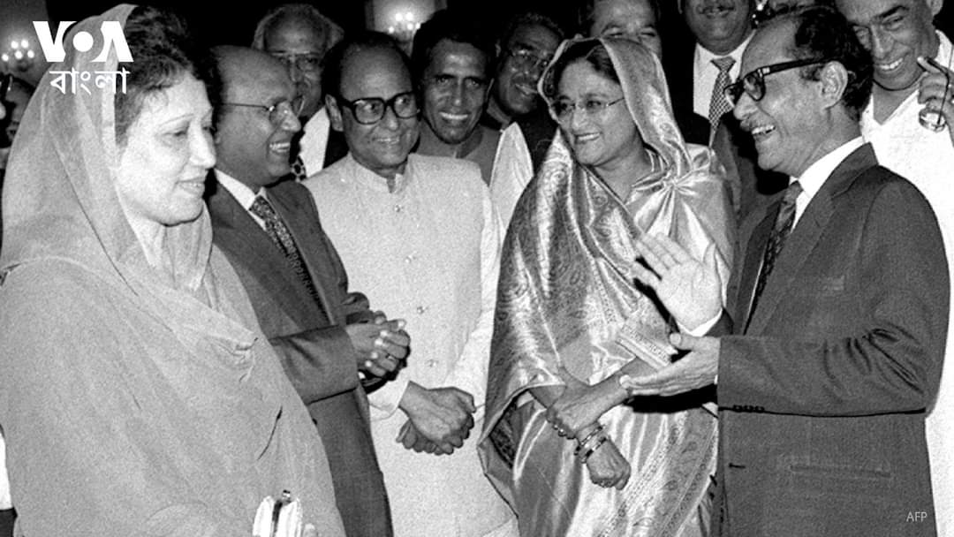

Slide 4
Independence of judiciary
Mode of appointment of judges
Long tenure
Security of services
Adequate salary of the judges
High qualification
Separate of judiciary from the control of executive
No practice after retirement

Slide 5
Types of Law
Our complex society requires many types of law, of which there are five major branches.
  Criminal Law
  Civil Law
  Constitutional Law
  Administrative Law
  International Law

Slide 6
I. Criminal Law
Modern criminal law is largely statutory and covers a specific category of wrongs that are considered social evils and threats to the community.
Offenses are usually divided into three categories.
  Petty offenses , such as traffic violations, are normally punished by a fine.
  Serious but not major offenses such as gambling and prostitution are misdemeanors, punishable by larger fines or short jail sentences.
  Major crimes, felonies, such as rape, murder, robbery, and extortion, are punished by imprisonment

Slide 7
II. Civil Law
Civil law defines the rights and responsibilities of individuals, government entities and private or non-government organisations in their interactions with each other
Marriage and divorce, inheritance, contracts, and bankruptcy are civil concerns.
In most English-speaking countries, common law supplements statutory law in civil cases.
A breach of a civil law right or obligation does not usually lead to criminal processes and sanctions.
Some cases can be pursued as both criminal and civil cases, as when the federal government accuses investment houses of wrongdoing and investors who lost money sue them.

Slide 8
III. Constitutional Law
The body of law that evolves from a constitution, setting out the fundamental principles according to which a state is governed and defining the relationship between the various branches of government within the state.
(Dictionary.com)
Written constitutions are usually general documents. Subsequent legislation and court interpretation must fill in the details.

Slide 9
IV. Administrative Law
Administrative law is the body of law created by the agencies and departments of the government, which carry out the laws passed by Congress or a state legislature.
It concerned with the powers and functions of the executive branch of the government, its organisations, their inter-relations with each other, citizens and the non-governmental entities.
The intention of administrative law is to provide for a legal framework for regulating the powers, procedures and acts of public administration.
It develops when agencies interpret statutes, as they must.
For example, Income Tax Tribunal determining disputes of aggrieved taxpayers, Securities Exchange Commission regulating and controlling the share markets

Slide 10
V. International Law
International law, also known as public international law and law of nations is the set of rules, norms, and standards generally accepted in relations between nations.
It establishes normative guidelines and a common conceptual framework to guide states across a broad range of domains, including war, diplomacy, trade, and human rights.
International law thus provides a means for states to practice more stable, consistent, and organized international relations.
For example, the Kyoto Protocol is an international agreement on climate change or the Convention on the Rights of the Child

Slide 11
Common Law vs Civil Law

Slide 12
Common Law
Common law, also known as case law, is a body of unwritten laws based on legal precedents established by the courts.
Common law draws from institutionalized opinions and interpretations from judicial authorities and public.
Common law is practiced in many parts of the world including Australia, Canada, Hong Kong, India, New Zealand, and the United Kingdom. juries.

Slide 13
Civil Law
Civil law is a comprehensive, codified set of legal statutes created by legislators.
A civil system clearly defines the cases that can be brought to court, the procedures for handling claims and the punishment for an offense.
The goal of standardized codes is to create order and reduce biased systems in which laws are applied differently from case to case.

Slide 14
How Common Law Can Marginalize Certain Groups
Historically, the traditions of common law have led to unfair marginalization or empowerment of certain groups.
Whether they are outdated or biased, past decisions continue to shape future rulings until societal changes prompt a judicial body to overturn the precedent.
For example, in England, common law as late as the 1970s held that, when couples divorced, fathers—rather than mothers—were entitled to custody of the children, a bias that in effect kept women trapped in marriages.

Slide 15
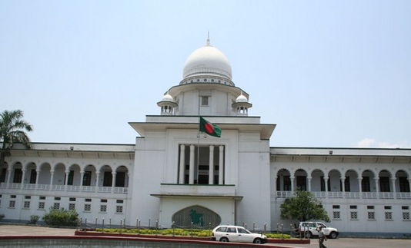
Judiciary System in Bangladesh

Slide 16
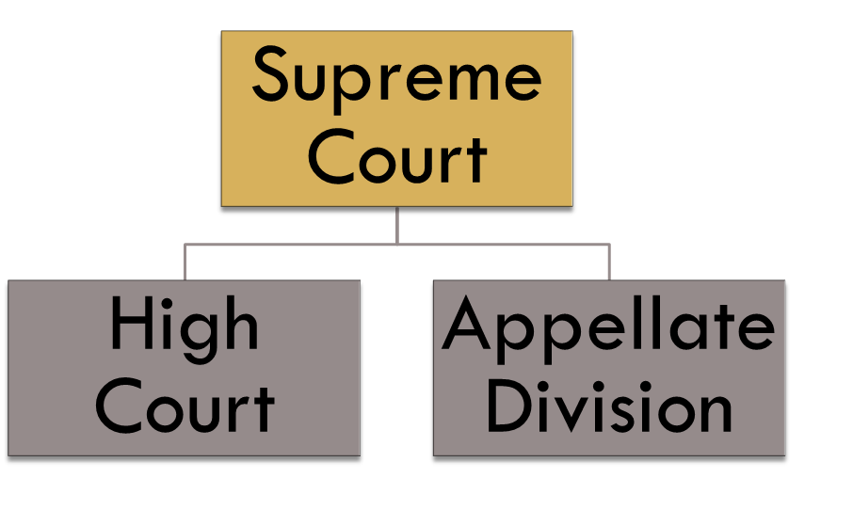
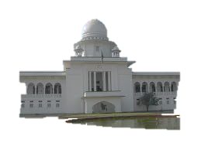
Judicial Branch
Supreme Court

Slide 17
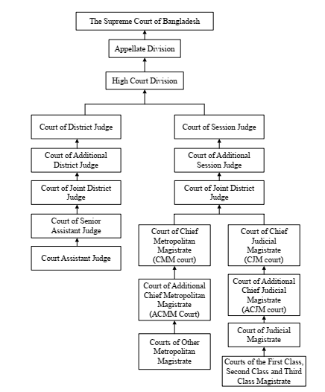
Civil court
Criminal court

Slide 18
Special Court
Family court (by Ass. Judge, deals maintenance, dissolution of marriage, dower)
Village Court (Village chairman)

Slide 19
Special Tribunal
Administrative tribunal
Labour appellate tribunal
The Artha Rin-Adalat
Land survey tribunal

Slide 20
Suggested readings
Agarwal, R. C. (2014). Political Theory: Principles of Political Science (New Delhi: S. Chand and Company Limited). (Chapter 22).
Panday, P. K., & Mollah, A. H. (2011). The judicial system of Bangladesh: an overview from historical viewpoint. International Journal of Law and Management.

Slide 21
Q?

